Slide 1

Boot camp
2018
Business Analytics Leadership Council

Slide 2
What is Power BI?
Power BI is a cloud based data analysis tool, which can be used for reporting and data analysis from wide range of data source.
It is not just a visualization tool such as Tableau
It is not just a cloud based tool for data analysis
It is not just a self-service data analysis tool such as PivotTable and PivotChart in Excel
Power BI is combination of all of those, and it is much more!

Slide 3
Power BI Components
Power BI made of 6 main components. Components of Power BI are:
• Power Query: Data mash up and transformation tool.
• Power Pivot: In-memory tabular data modelling tool
• Power View: Data visualization tool
• Power Map: 3D Geo-spatial data visualization tool
• Power Q&A: Natural language question and answering engine.
• Power BI Desktop
A powerful companion development tool for Power BI There are many other parts for Power BI as well, such as;
• PowerBI.com Website; which Power BI data analysis can be shared through this website and hosted there as cloud service
• Power BI Mobile Apps; Power BI supported in Android, Apple, and Windows Phones.

Slide 4
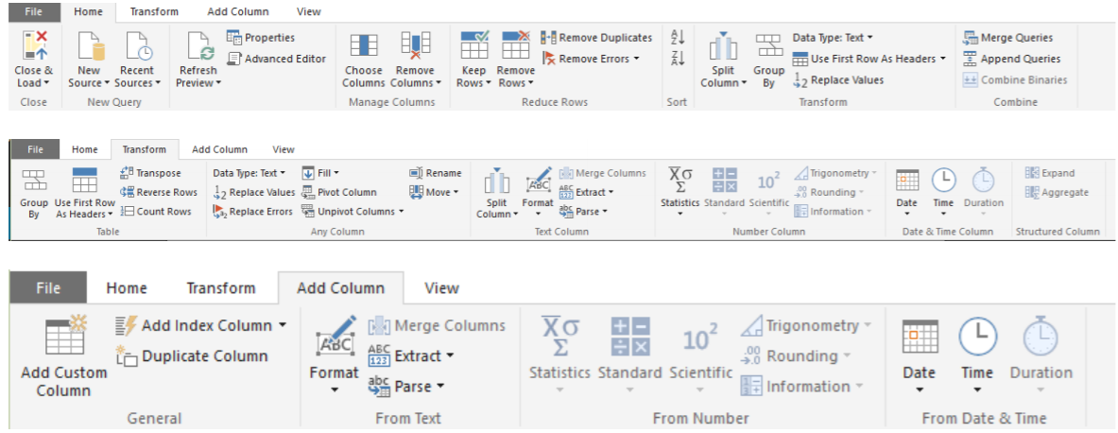
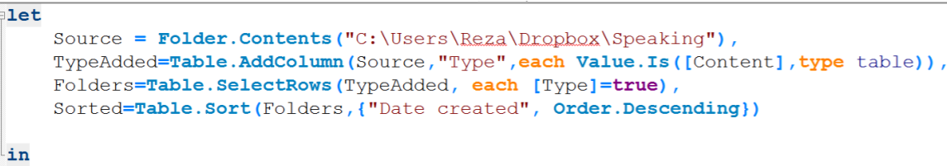
Power Query
Power Query look at the data values with data types such as : Table, Record, List, DateTime, Text, Number, Boolean and etc
There are two way to apply these transformations; 1. From Query Editor: Graphical User Interface 2. From M query language: scripting language .
Query Editor
M Language

Slide 5
Power Query – Hands On!
Movies Data Mash-up
Open the following url: http://www.boxofficemojo.com/alltime/world/
Query Editor has four main sections (numbers matched to screenshot above);
Main data set pane; This is the central area that the result set will be displayed as preview with limited number of rows
List of Queries; Left hand side pane will show list of all queries in this solution or file
Query Settings pane; Properties such as Name of the query can be set here. Also list of all applied steps to the current query is visible in this pane.
Transformations Menu; Power Query has many transformations options in GUI that are available through the menu in top section

Slide 6
Power Query – Hands On!
As you see in query editor all of these queries are separate from each other. Let’s combine them altogether. in database and SQL world that can be done with UNION.
Use a Query as a Reference
Append Queries
For append to works best queries have to be in the same structure (number of columns, order of columns, data type of columns).
Extract First Characters
Enter the URL as: http://www.imdb.com/chart/top
Remove Columns
Split-Columns

Slide 7
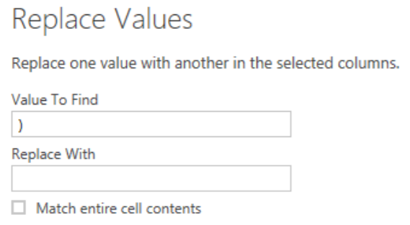
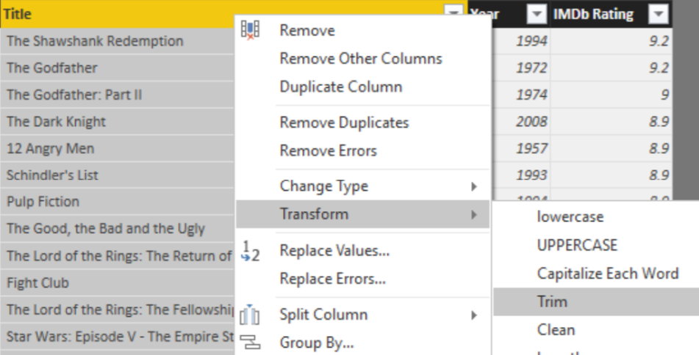
Power Query – Hands On!
Replace Values Trim
Check Applied Steps
Awesome, our work with this data set has been finished as well!

Slide 8
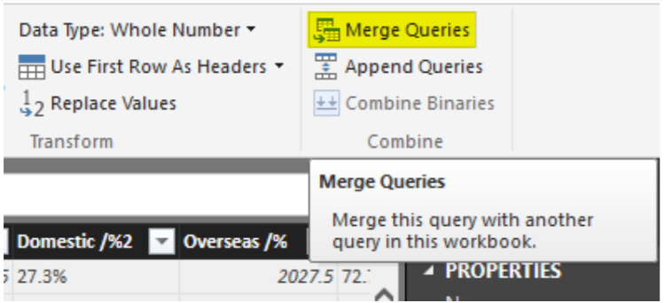
Power Query – Hands On!
Merged Queries Merge Queries is equivalent to Join in SQL or database terminology.
Notice in screenshot above that merge dialog mentioned only 58 records out of 615 movies matched! Such a pity!!
Expand Columns

Slide 9
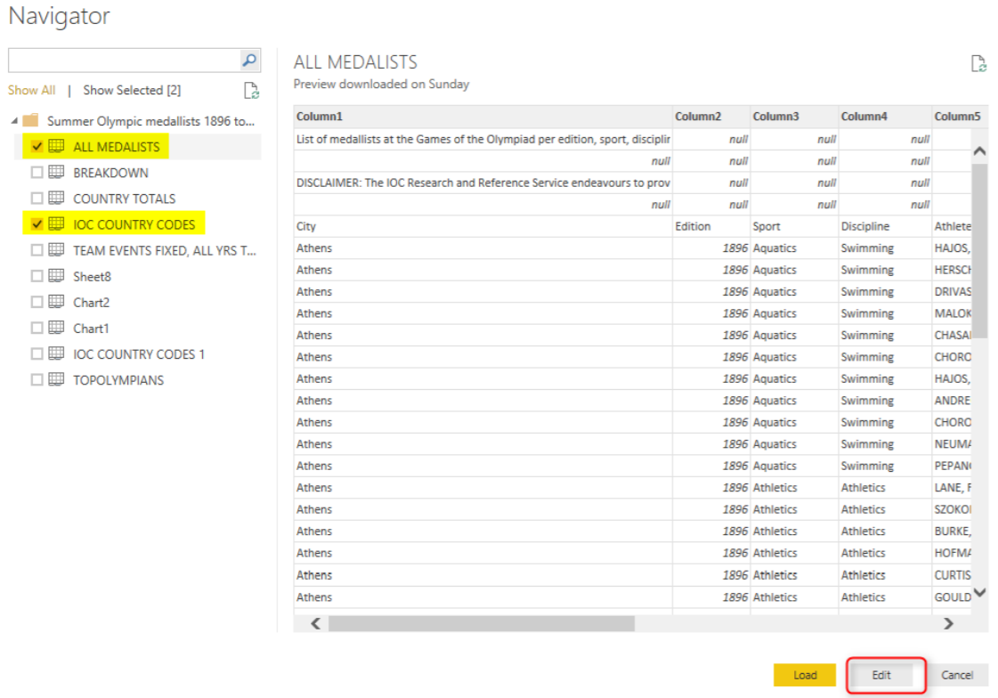
Power BI – Using Excel
Olympic Games Data (1896-2008)
Load All Medalists & IOC Country Code sheets

Slide 10
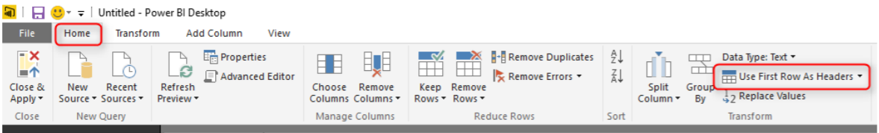
Power BI – Using Excel
Remove Rows All Medalists query contains four heading rows which we don’t need them (it is just title and disclaimer) so better to remove those;
Go to All Medalists query and then click on Remove Rows in the Home menu. From the Remove Rows popup menu choose Remove Top Rows
Use First Row As Headers

Slide 11
Power BI – Using Excel
Close & Load
A bit of Data Modeling Let’s create the relationship between All medalists and IOC Country Code. For doing this go to Relationship tab in Power BI Desktop and the click on Manage Relationship

Slide 12
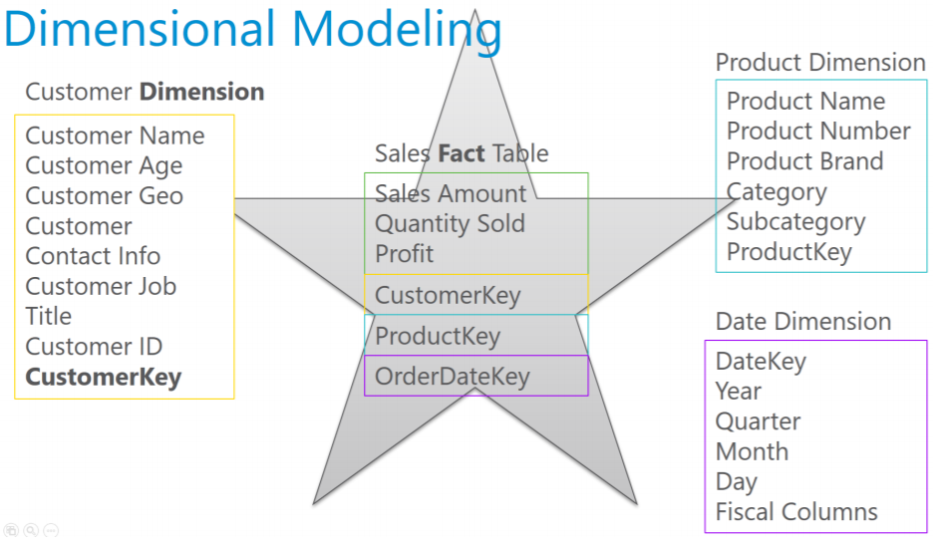
Data Preparation; First and Foremost Important Task in Power BI

Slide 13
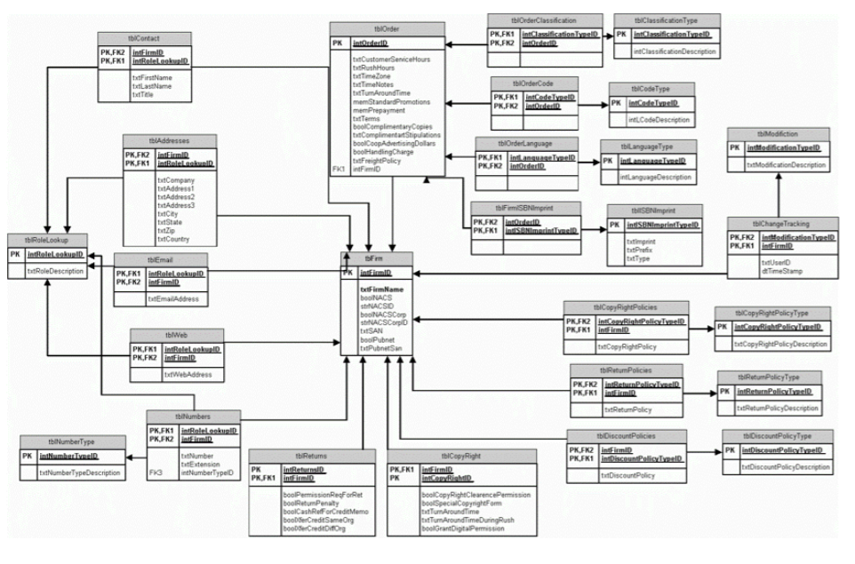
Why Dimensional Modelling?
For building a data model for BI system you need to avoid this type of modelling!

Slide 14
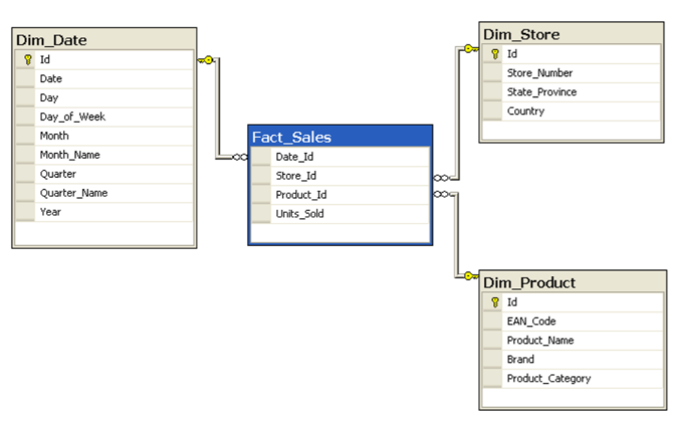
Why Dimensional Modelling?
The model is hard to understand for a Report User
Too many tables and many relationship between tables makes a reporting query (that might use 20 of these tables at once) very slow and not efficient.
Efficient Solution

Slide 15
Star Schema
How to Design a Star Schema?
Fact Table Fact tables are tables that are holding numeric and additive data normally. For example quantity sold, or sales amount, or discount, or cost, or things like that.
Dimension Table Any descriptive information will be kept in Dimension tables. For example; customer name, customer age, customer geo information, customer contact information, customer job, customer id, and any other customer related information will be kept in a table named Customer Dimension.

Slide 16
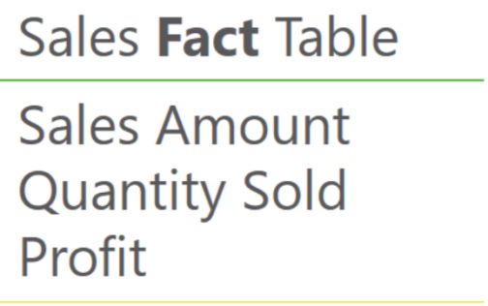
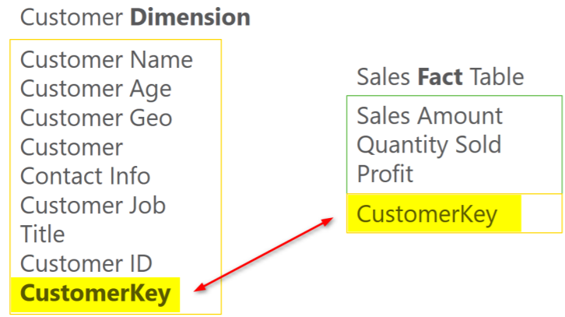
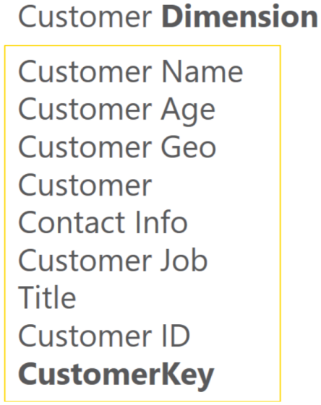
Star Schema
Fact Table
Dimension Table

Slide 17
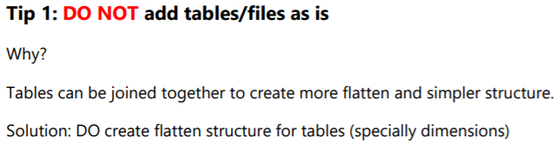
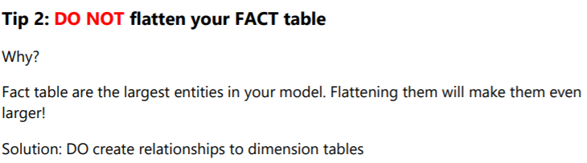
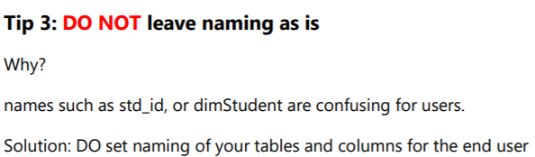
Dimensional Modelling Tips

Slide 18
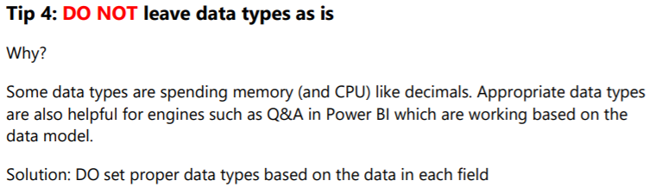
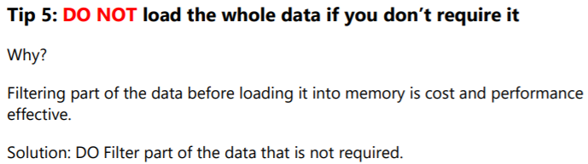
Dimensional Modelling Tips

Slide 19
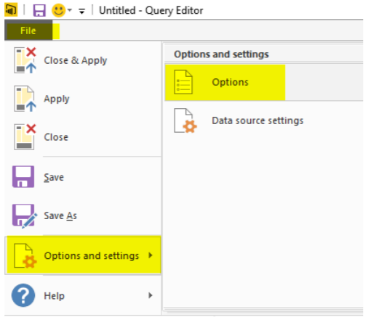
Flawless Date Conversion in Power Query
Depending on locale on the system that you are working with Date Conversion might return different result.
Most of the countries uses YMD format, however some of them use MDY or DMY more frequently.
Load dataset Date.xlsx
Go to File, Options and Settings, then Options.

Slide 20
M Language
M is the powerful language behind the scene of Power Query. Any transformation you apply will be written in M language.
M is much more powerful than the graphical interface of Power Query!
Syntax of M
let x=1
in x
let: definition of all variables
in: output! Yes, in actually means out! just named as in. everything you put in this block will be the output of your query
So basically, the query below means defining a variable named as x, assigning the value 1 to it, and showing it as the result set. so the query will return 1.

Slide 21
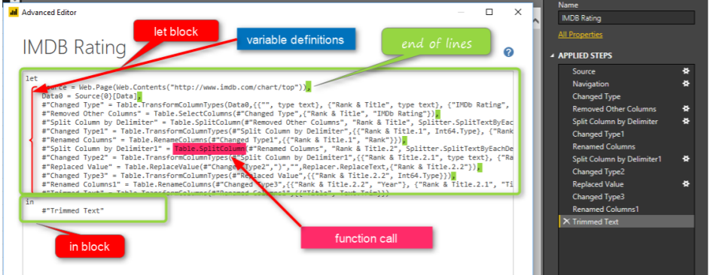
You already created M Query!
• let and in block
• variable names matching steps applied in the query
• some variable names with hashtag and double quote: #”var name”
• end of the line characters: comma • calling many functions

Slide 22
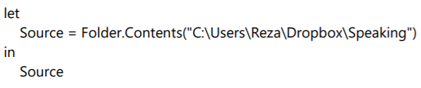
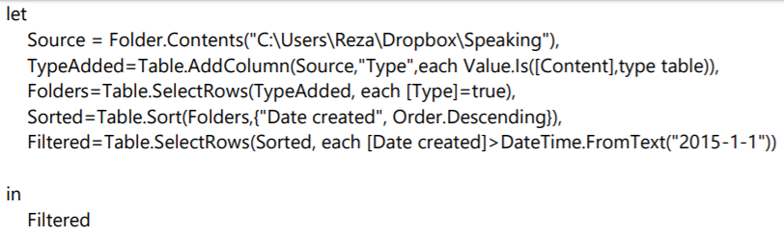
M Language Examples
Fetch All Files and Folders
Fetch Only Folders Created after Specific Date

Slide 23
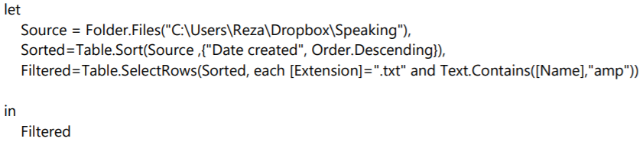
M Language Examples
Fetch Only Files with .txt extension and name similar to “amp”

Slide 24
Custom Functions in Power BI
Custom Function in simple definition is a query that run by other queries.
The main benefit of having a query to run by other queries is that you can repeat a number of steps on the same data structure.
Benefits of Custom Function
Re-Use of Code
Increasing Consistency
Reducing Redundancy

Slide 25
Custom Functions-Hands On!
Open URL: http://publicholiday.co.nz/
Building a Main Query
Open a Power BI Desktop and start by Get Data from Web http://publicholiday.co.nz/nz-public-holidays-2016.html
Parameter Definition Parameters are ways to pass values to other queries. Click on Manage Parameters menu option in Query Editor, and select New Parameter.

Slide 26
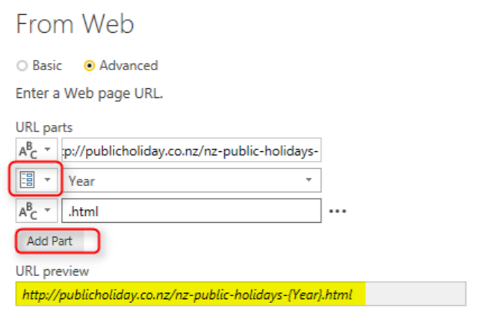
Custom Functions-Hands On!
URL Parameterization In our case, the URL which contains 2016 as the year, can be dynamic using this parameter.
Add Custom column ‘Year’.
Go to Source

Slide 27
Custom Functions-Hands On!
Convert Query to Function After using parameter in the source of query we can convert it to function. Right click on the Table 0 query and select Create Function.
Using Generator Generators are functions that generate a list. This can be used for creating loop structure in Power Query, In your Query Editor Window, create a New Source from Home tab, and choose Blank Query. This will create a Query1 for you. Click on Query1 in Queries pane,
and in the Formula bar type in below script: = List.Numbers(2015,5)
Convert this to Table

Slide 28
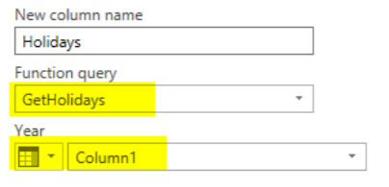
Custom Functions-Hands On!
Consuming Function To consume a function in Query Editor from a table. Go to Add Columns, and click on Invoke Custom Function option. In the Invoke Custom Function window, choose the function (named GetHolidays), the input parameter is from the table column name Column1, and name the output column as Holidays.
Now when you click on OK, you will see a new column added with a table in each cell.

Slide 29
Data Visualization
What is Interactivity of Power BI Visuals? Power BI visuals are interacting with each other. Selecting an item in a visual will effect on the display of another chart.
Changing the Interaction To change the interaction of a chart with other charts, simply select the main chart (the chart that you want to control effect of that on other charts), and then from Visual Tools menu, under Format, click on Edit Interactions.

Slide 30
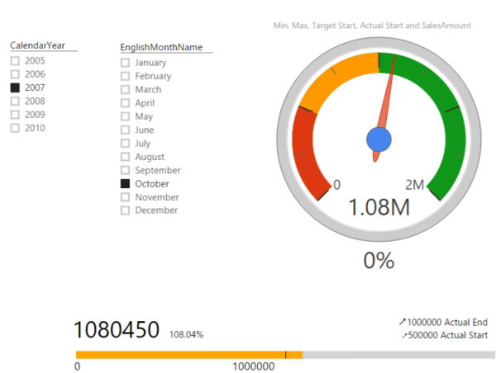
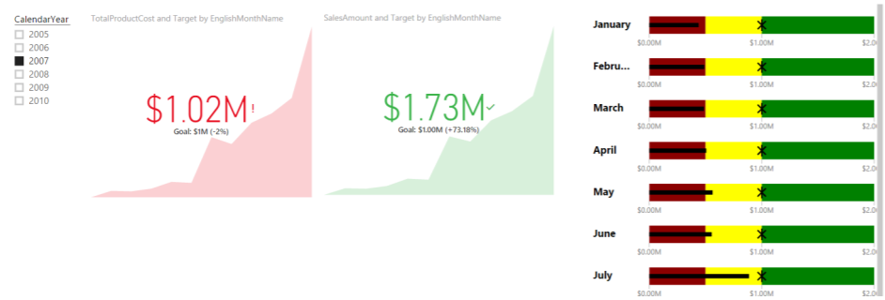
KPI
What is KPI? Key Performance Indicator is a measure for business to understand how they perform in specific area that is important and many times critical for their business.
KPI Elements KPIs measuring something and show trend and status. So they have components to work with as below: • Value; The main measure which we want to evaluate • Target; What we want to compare the Value with • Trend; How value performs in a time period, is it going upward, downward? • Status; What is the current status of Value against Target?

Slide 31
Custom Visuals
Synoptic Panel by SQL BI With this visualization you can define regions in any picture or images, and map data points to the image in your Power BI report.
Visit: https://synoptic.design/
Load car-data in Power BI. Open below link: https://www.123rf.com/photo_1648382_sw-car--layout-for-presentation--vector.html
Upload image to synoptic designer
Define Areas
Export svg file
Import svg in Synoptic Custom Visual

Slide 32
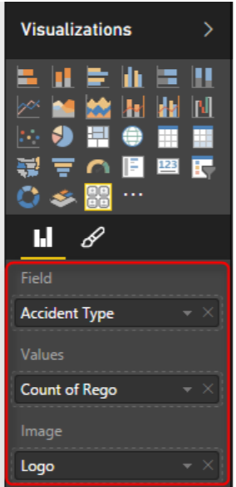
Custom Filters using Chiclet Slicer
Create another spread sheet with accident types and a field called logo which is a URL for an image related to each item.
Change data type to web url
Now in the Chiclet Slicer custom visual I set fields as accident type, and Image as Logo, and count of regno. as Values.

Slide 33
Integrating Shape Maps
Shape Map allows you to add your own Map
Consists of geometry data – points, boundaries, lines etc.
Convert it to TOPO JSON for using it in PowerBI.
Source: http://shpescape.com/
Verify regions in Format -> Shape section with clicking on “View Map Keys”
Cons: You cannot add other layers of map to it (for example if you want to add heatmap, or bubbles to it)

Slide 34
Step Beyond the 10GB Limitation of Power BI
Live Connection With Power BI we can connect live to some data sources; On premises or in cloud. Live connection won’t import data into the model in Power BI. Live connection brings the metadata and data structure into Power BI, and then you can visualize data based on that. with every visualization a query will be sent to the data source and brings the response.

Slide 35
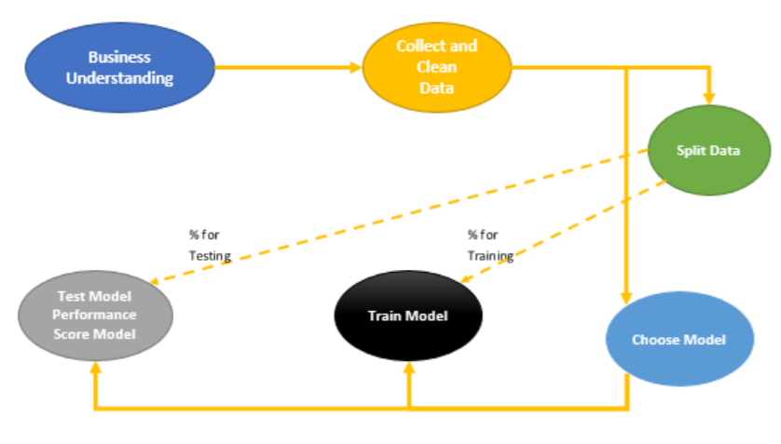
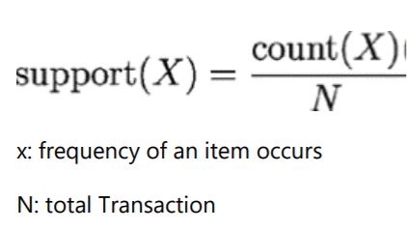
Market Basket Analysis Integrating R with PowerBI
This analysis examines customer purchased behaviour. For instance, it suggests that customers often purchase shampoo and conditioner together.
Association rules is another name for Market Basket analysis. Association rules are in the form if X then Y.
For example: 60% of those who buy life insurance also buy health insurance.
Eg. From out four main transactions (4 customers), 2 of them purchased salt and pepper together. so the support will be 2 divided by 4 (all number of transaction. 2/4 (0.50)

Slide 36
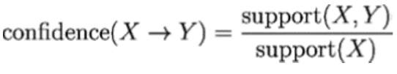
Market Basket Analysis Integrating R with PowerBI
Another important measure is about the rule’s confidence that is a measurement of its predictive power or accuracy.
For example we want to know what is the probability that people purchase Salt then they purchase Pepper or wise versa.
Confidence (Salt–>Pepper), we have to calculate the frequency of purchasing Salt (Support (Salt))
If,
Support for Purchasing Salt is 3 out of 4 (0.75)
Support for Purchasing Salt and Pepper is 0.5

